Slide 1

ECE 802, Electric Motor Control
Synchronous Machines in Micro Grids

Slide 2
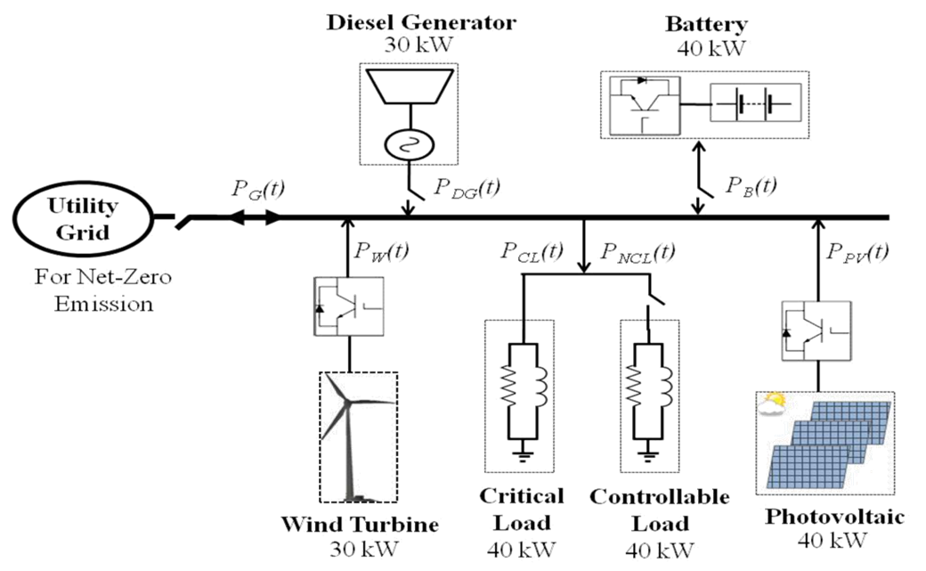
Micro Grids
Generally, any stand-alone system with “finite” generation is considered to be a micro grid
Examples, Army forward operating base, Naval ship power system, etc.
Can be operated in grid-connected or islanded mode
Sometimes seen as a bridge between the traditional power system and the future power system which will involve more renewable energy sources

Slide 3
Synchronous Machine Droop Control
Control for paralleling synchronous machines including cases where the machines are of different power rating
Typically, frequency is reduced or "drooped" with increasing generated real power
Typically, voltage is drooped with increasing generated reactive power
Droop control is usually used in micro grids in conjunction with a higher-level control to set the grid frequency

Slide 4
Synchronous Generator Control Options
Connection to the utility (an infinite buss)
Utility frequency sets machine steady-state speed
Torque is controlled to supply real power
Field voltage is controlled to supply both positive and negative reactive power
Connection to passive loads
Speed control adjusts frequency
Field control adjusts voltage
Multiple machines supplying passive loads
Speed is drooped depending on real power from generator
Field voltage is drooped depending on reactive power from generator

Slide 5
Frequency Droop Equations
Typically, machine runs at rated frequency with no load and droops according to
ω_{b} - base speed (rad/s)
P_{gen} - generator output real power (W)
P_{gen,rated} - rated generator power (W)
d - droop factor
Alternatively, the machine speed can reach rated value at rated power according to

Slide 6
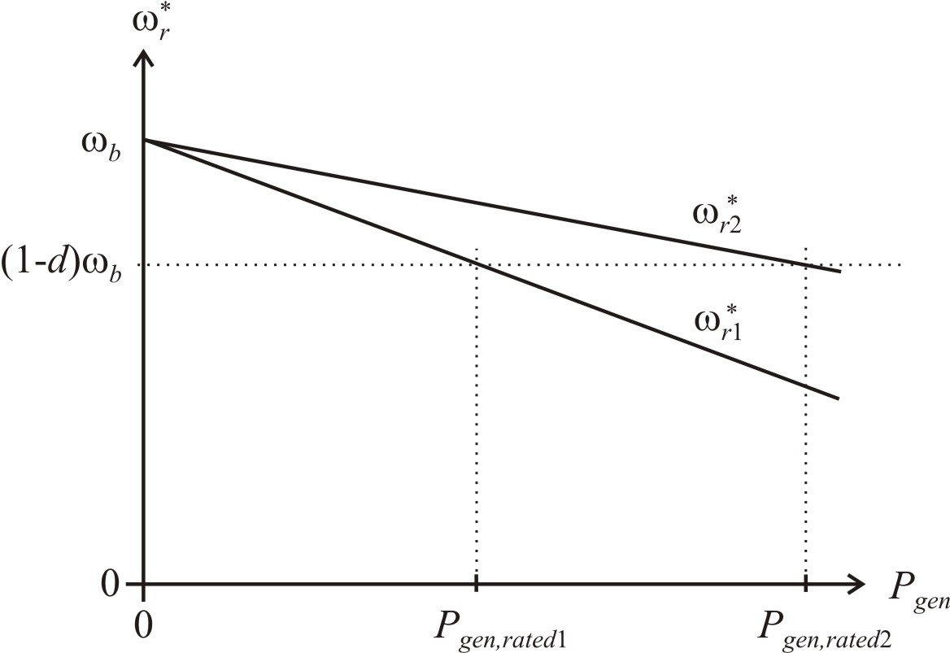
Two Generators Sharing Power

Slide 7
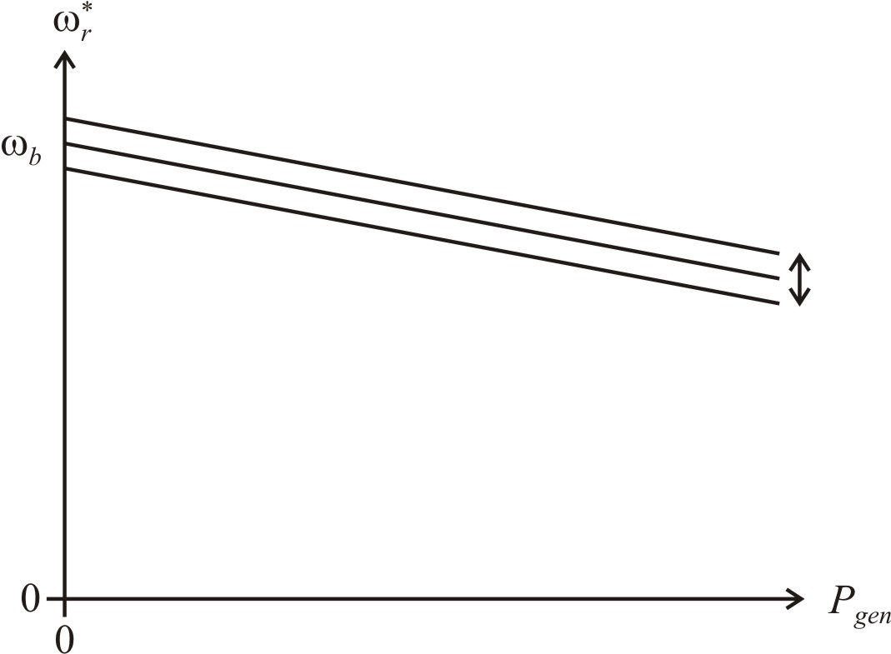
Higher-Level Control
to Adjust Micro Grid Frequency
Adjust base frequency of droop controllers up or down to set system frequency for a given load

Slide 8
Voltage Droop Equations
Droop voltage based on generator reactive power
ω_{b} - base speed (rad/s)
Q_{gen} - generator output reactive power (VA)
Q_{gen,rated} - rated generator reactive power (VA)
d - droop factor

Slide 9
Simulation Example
Generator ratings
G3 - 4MW max
G2 - 2MW max
G1 - 2MW max
Total load
6 MW
1.5 MVAR

Slide 10
Generator G1

Slide 11
Generator G1 Droop Controls
P_{gen,rated} = 2 MW, ω_{b} = 377 rad/s, d = 3%
Q_{gen,rated} = 1.5 MVAR (assuming 0.8 pf), V_{B} = 260 V, d = 5%

Slide 12
Generator G2 Droop Controls
P_{gen,rated} = 2 MW, ω_{b} = 377 rad/s, d = 3%
Q_{gen,rated} = 1.5 MVAR (assuming 0.8 pf), V_{B} = 260 V, d = 5%

Slide 13
Generator G3 Droop Controls
P_{gen,rated} = 4 MW, ω_{b} = 377 rad/s, d = 3%
Q_{gen,rated} = 3 MVAR (assuming 0.8 pf), V_{B} = 260 V, d = 5%

Slide 14
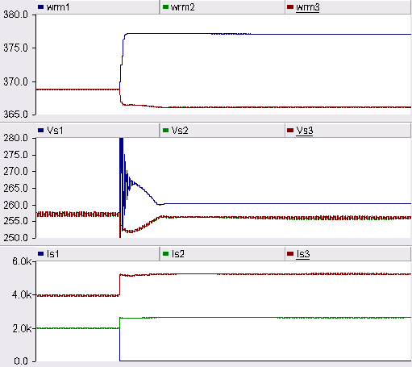
Generator Speeds, Voltages, and Currents
<- G1 drops offline

Slide 15

Generator Real and Reactive Powers
<- G1 drops offline

Slide 16
Laboratory Micro Grid
Synch. Machine G1 and G2 | R_{Load} | RL_{Load}
230V, 2.5 kVA, 1800 rpm | 500 W | 500 W and 500 VAR

Slide 17
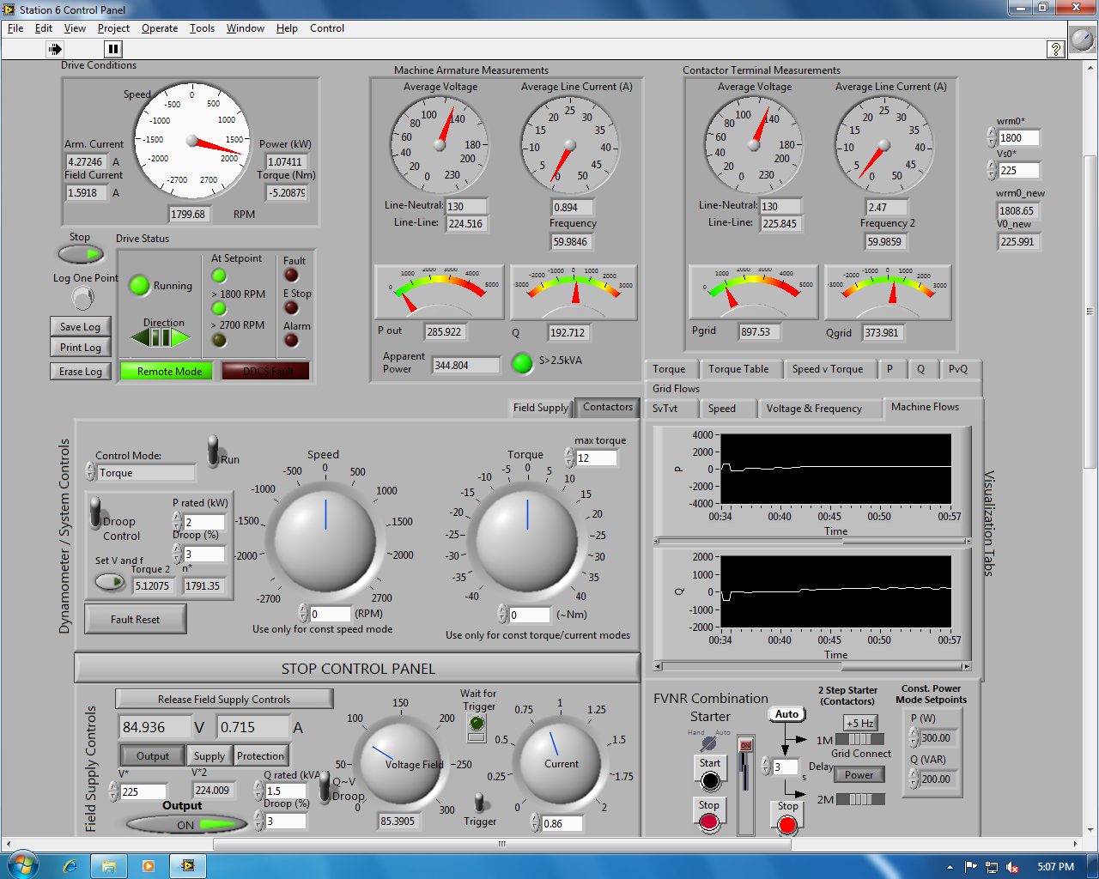
Main Control Screen in LabVIEW

Slide 18
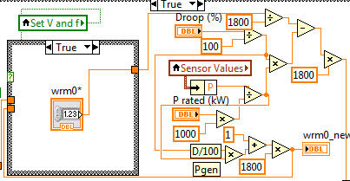
Speed Droop Control

Slide 19
Micro Grid Study
25s Synchronize generator G1 to the grid (close S1)
105s Synchronize generator G2 to the grid (close S2)
125s Switch on loads
175s Adjust real and reactive power of the generators to match the loads
225s Disconnect the grid and put generators in droop mode (open S1)
250s Switch off RLLoad1
300s Adjust droop controls so frequency and voltage to match the grid
325s Synchronize the micro grid to the main grid (close S1)
375s Command synchronous generators to generate less power
450s Command generator G1 to supply zero reactive power

Slide 20
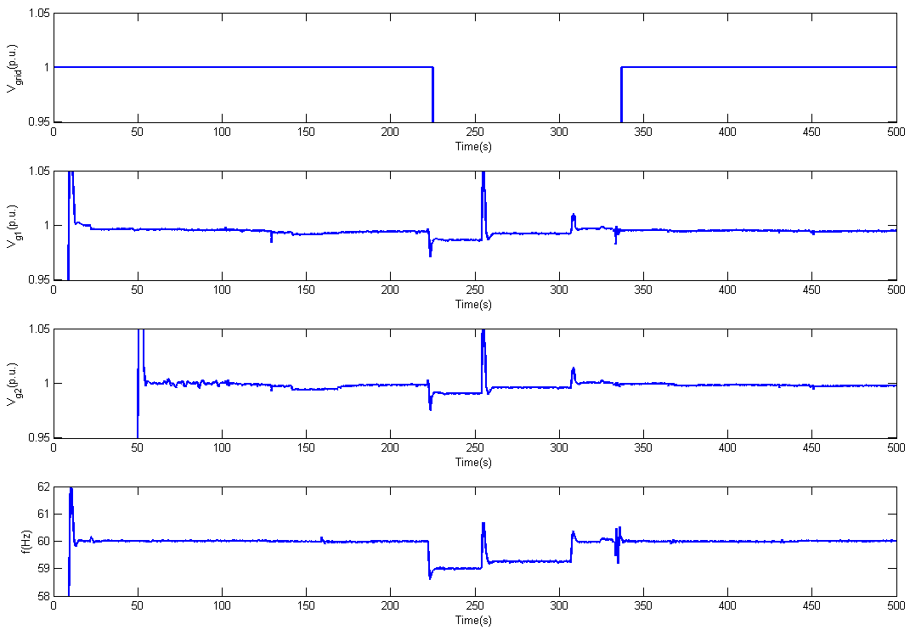
Voltage and Frequency

Slide 21
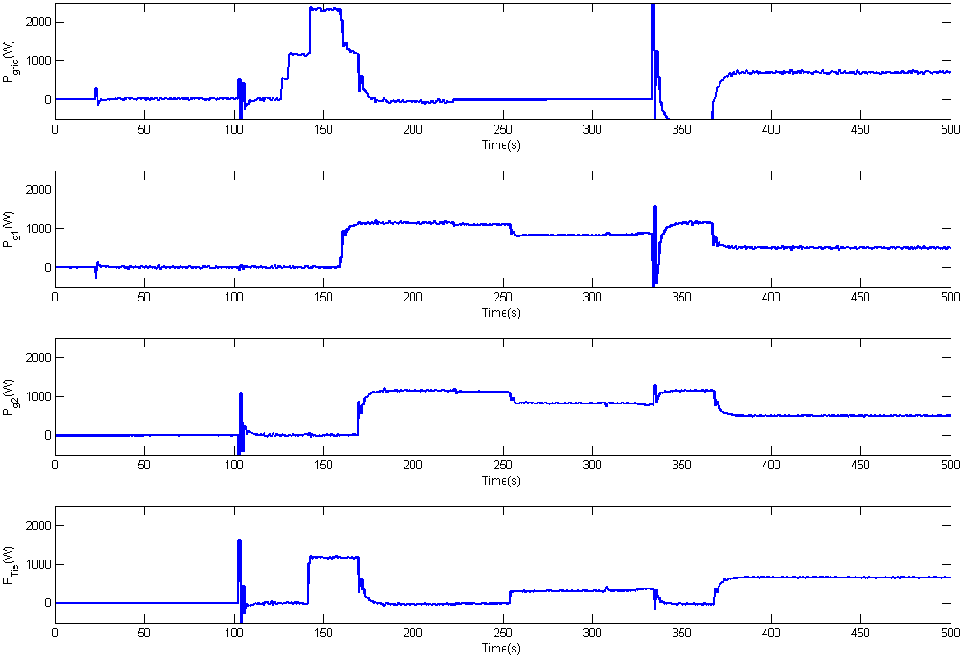
Real Power

Slide 22
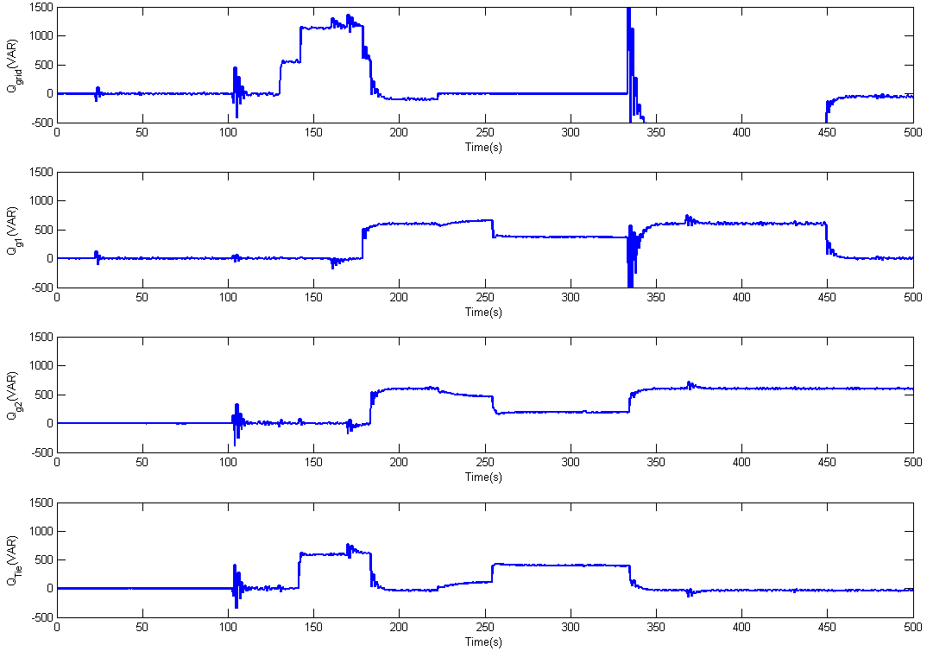
Reactive Power

Slide 23
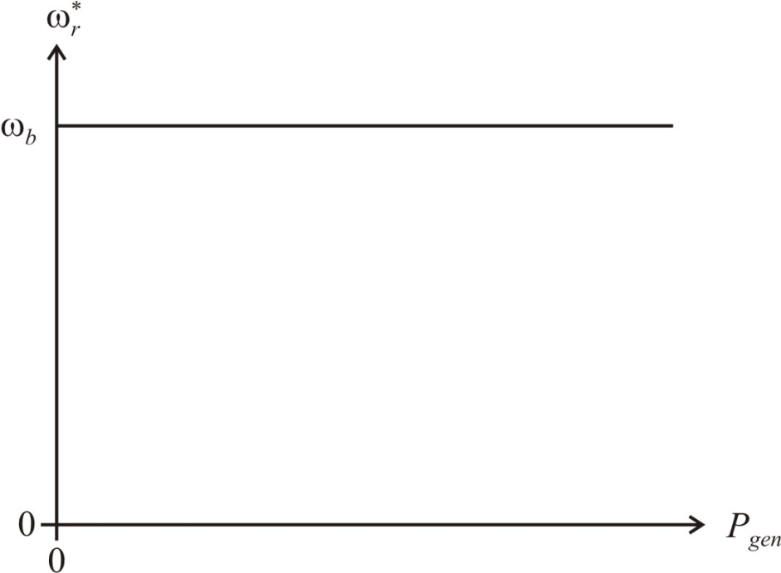
Synchronous Machine Isocronous Control
Regulates voltage and frequency to set values
Requires additional communication between generators for power sharing (paralleling generators)
Similar to droop control with d=0

Slide 24
Simulation Example
Generator ratings
G3 - 4MW max
G2 - 2MW max
G1 - 2MW max
Total load
6 MW
1.5 MVAR

Slide 25
Generator G3 Isocronous Controls
Note: d=0

Slide 26
Generator G1 and G2 Controls
Torque commanded to control P, Field commanded to control Q
Reference values set to ½ of G3

Slide 27
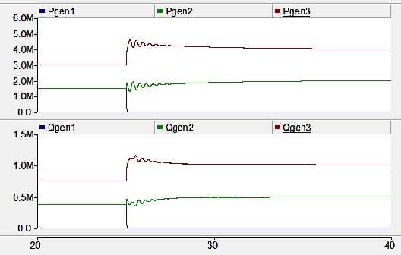
Generator Real and Reactive Powers
<- G1 drops offline

